Slide 1


Analyzing Sales Data for Coffee Shops
This SQL project explores insights derived from analyzing sales data for coffee shops.
Gain a better understanding of customer preferences, identify trends, and improve business strategies.
by Abhay Kumar

Slide 2



X`
Project Introduction
1
Data-Driven Insights
2
Informed Decision-Making
This project aims to provide clear insights into your sales data by analyzing transaction details and identifying patterns.
By understanding the data, we can identify areas for improvement and make informed decisions to boost profitability.
3
Operational Efficiency
Data analysis can help streamline your operations and improve efficiency, ensuring smooth running of your coffee shop.

Slide 3





Objectives
Analyze how sales change over time.
Identify periods with highest sales volume.
Compare sales performance across different coffee shops.
Analyze individual product sales and popularity.

Slide 4
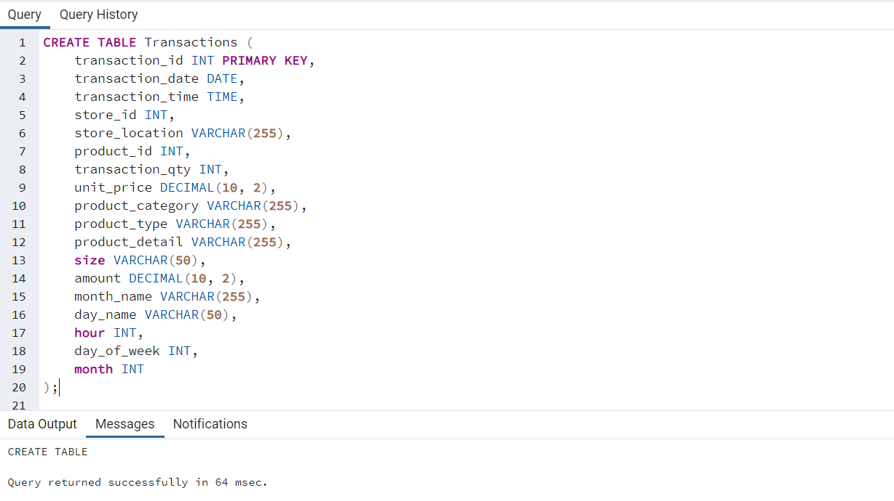
Creating table after connecting to database

Slide 5
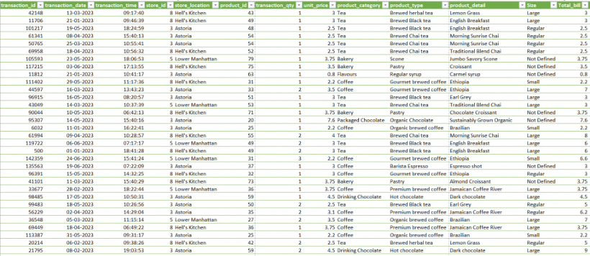
Data Visualization
Data visualization helps to identify trends, patterns, and anomalies in data. Visualizing data can be instrumental in making informed decisions, improving operational efficiency, and uncovering valuable insights.
We utilize different types of charts and graphs to represent data. For example, bar graphs can illustrate sales trends over time, while pie charts can show the proportion of sales from different product categories.

Slide 6
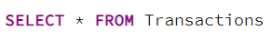
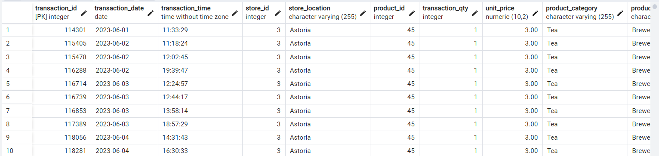
First view

Slide 7
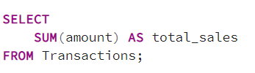
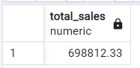
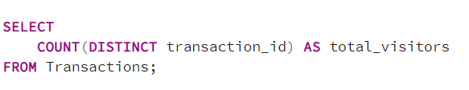
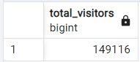
SQL Queries for Analysis
Total Sales:
Total Sales:

Slide 8
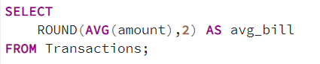
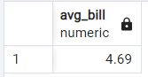
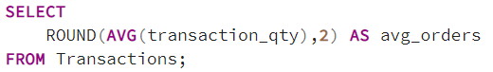
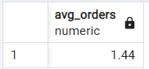
SQL Queries for Analysis
Avg Bill:
Avg Orders:

Slide 9
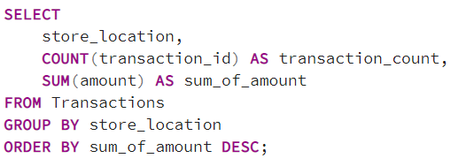
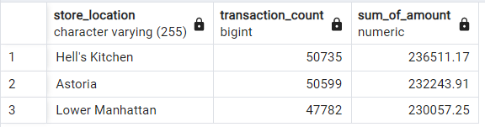
Footfall Over Store Locations

Slide 10
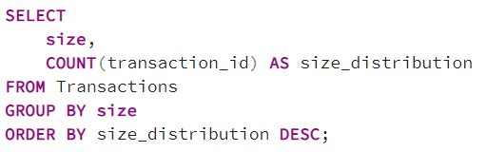
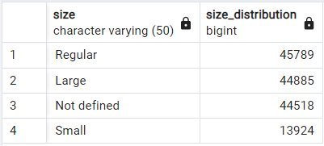
Sales by Product Size

Slide 11
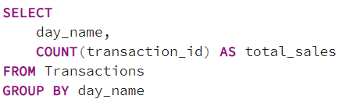
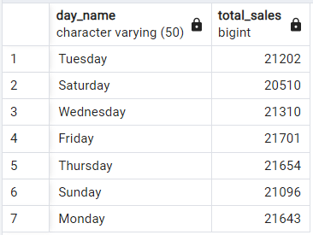
Sales by Day of the Week

Slide 12
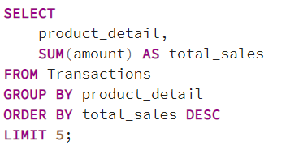
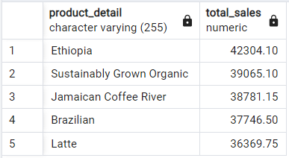
Top 5 Products by Sales

Slide 13
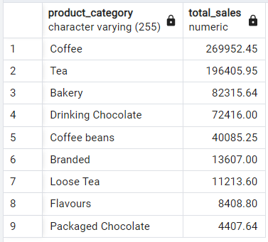
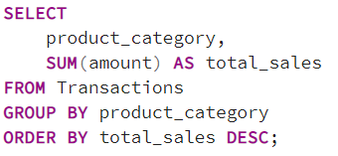
Category Percentage Distribution

Slide 14
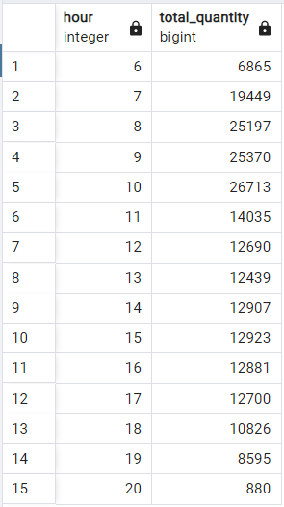
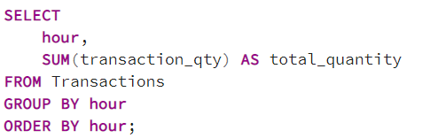
Hourly Sales Trend

Slide 15

Insights and Recommendations
Total Sales & Visitors: Total sales and visitor numbers give an overview of
the coffee shop's performance.
Peak Hours and Days: Identifying peak hours and high-performing days helps
in better staffing and inventory planning.
Store Performance: Analyzing store-wise performance helps identify high-performing locations and potential underperformers.
Product and Size Preferences: Knowing top-selling products and size preferences aids in optimizing the menu and inventory.
Category Contributions: Understanding category-wise contributions helps allocate marketing efforts effectively.

Slide 16

Future Scope
Integrate Predictive Analysis: Use machine learning algorithms to forecast sales trends.
Customer Segmentation: Add customer demographics to identify target audiences.
Real-Time Dashboards: Build live dashboards using Power BI or Tableau for continuous monitoring.

Slide 17


Store Performance
Comparative Analysis
Compare the performance of different stores to identify top performers and underperformers.
Operational Improvements
Use insights from data analysis to optimize store operations and increase sales.

